Slide 1
Chapter 03: Transport Layer
Freshman Seminar
2022.02.22
Sumin Sohn

Slide 2
Contents
3.1 Introduction and Transport-Layer Services
3.2 Multiplexing and Demultiplexing
3.3 Connectionless Transport: UDP
3.4 Principles of Reliable Data Transfer
3.5 Connection-Oriented Transport: TCP
3.6 Principles of Congestion Control
3.7 TCP Congestion Control

Slide 3
3.1 Introduction and Transport-Layer Services

Slide 4
Transport-Layer Protocol
Transport-layer protocol provides logical communication between application processes running on different hosts
Logical communication: from an application’s perspective, it is as if the hosts running the processes were directly connected
Implemented in the end systems not in network routers
Sending side
Converts application-layer messages to transport-layer segments and passes to network-layer
Receiving side
Processes received segment from the network-layer, making data in the segment available to application
More than one transport-layer protocol may be available

Slide 5
Layers and Packet Terminology
Application layer
Application data
Transport layer
Transport-layer segments
Splitting application layer data into small chunks and encapsulating with header
Network layer
Datagram
Transport-layer segments are encapsulated within a network-layer packet

Slide 6
Relationship Between Transport and Network Layers
Transport-layer protocol
Provides logical communication between processes running on different hosts
Network-layer protocol
Provides logical communication between hosts
Within end system, transport protocol move message from process to network edge and vice versa
Transport layer doesn’t know how messages are moved within network core
Similarly, router doesn’t recognize any information thar transport layer added

Slide 7
Internet-Protocol(IP)
IP provides logical communication between hosts
IP service model is a best-effort delivery service(unreliable service)
Does not guarantee segment delivery
Does not guarantee orderly delivery of segments
Does not guarantee the integrity of the data

Slide 8
Overview of the Transport Layer
Purpose of transport-layer protocol
Extend host-to-host delivery to a process-to-process delivery service running on hosts
TCP and UDP provide process-to-process data delivery and error checking
UDP(User Datagram Protocol)
Unreliable, connectionless service
TCP(Transmission Control Protocol)
Reliable, connection-oriented service
Provide serveral additional services
Reliable data transfer
Congestion control

Slide 9
3.2 Multiplexing and Demultiplexing

Slide 10
Transport-Layer Scheme
Sockets
Doors through which data passes from between process and network
Process can have one or more sockets
Transport layer delivers data to socket, rather than the process itself
Structure of sockets and segments
Each socket has a unique identifier
Format of identifier depends on whether socket is UDP or TCP socket
Each transport-layer segment has a set of fields
Transport layer examine these fields to identify receiving socket
And direct the segment to that socket
Notes:
구조이자, multiplexing을 하기 위해 요구되는 것
Field가 결국 port

Slide 11
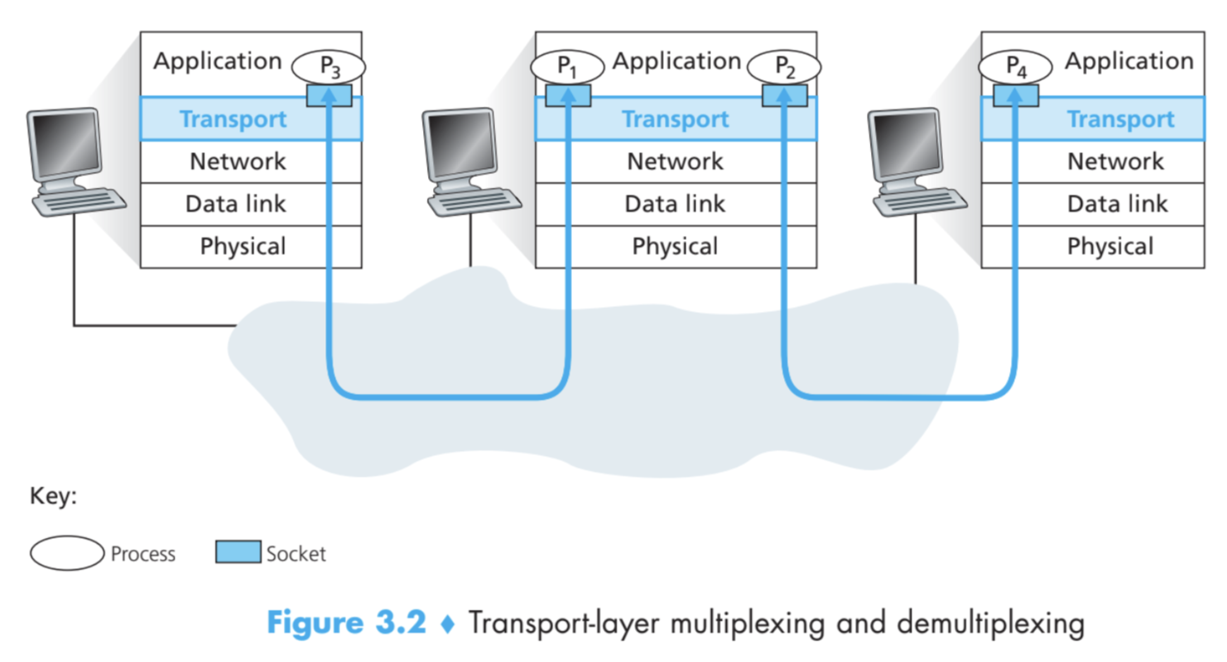
Multiplexing and Demultiplexing: Transport-Layer Protocol
Multiplexing
Gathering data from sockets
Adding header to create segments
Passing down to network layer
Demultiplexing
Delivering the data in a transport-layer segment to the correct socket

Slide 12
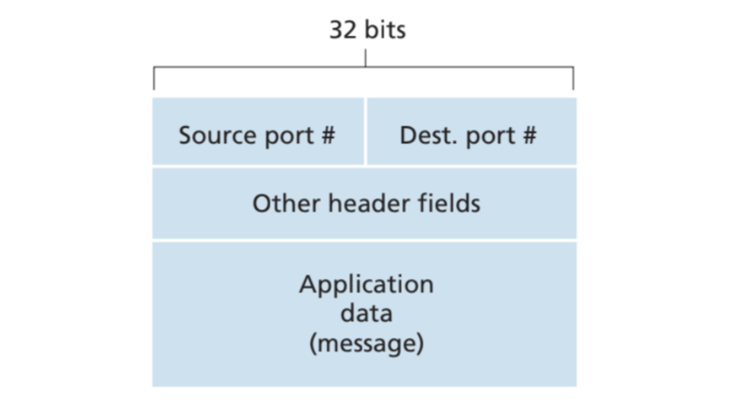
Segment Fields for Multiplexing and Demultiplexing
Source / destination port number fields
16-bit number
0~65535
0~1023 are reserved for well-known port numbers
Multiplexing and demultiplexing scheme
Each socket is assigned with port number
When segments arrives
Transport layer examines the destination port number
Directs to corresponding socket

Slide 13
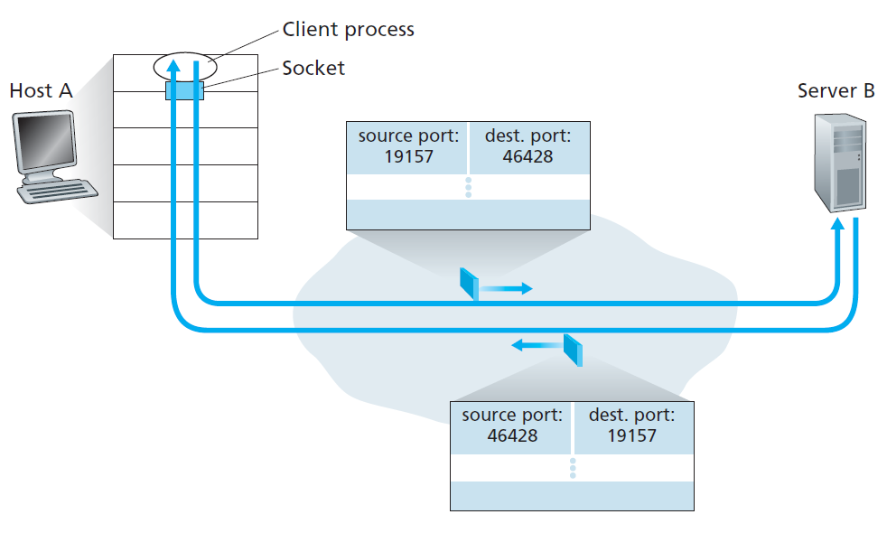
Connectionless Multiplexing and Demultiplexing
Case for UDP
Transport layer automatically assigns a port number to the socket
Not being used by any other socket
UDP socket is identified by two-tuple: (dest IP, dest port #)
Source port number serves as part of return address
Destination port of B-to-A segment = source port of A-to-B segment

Slide 14
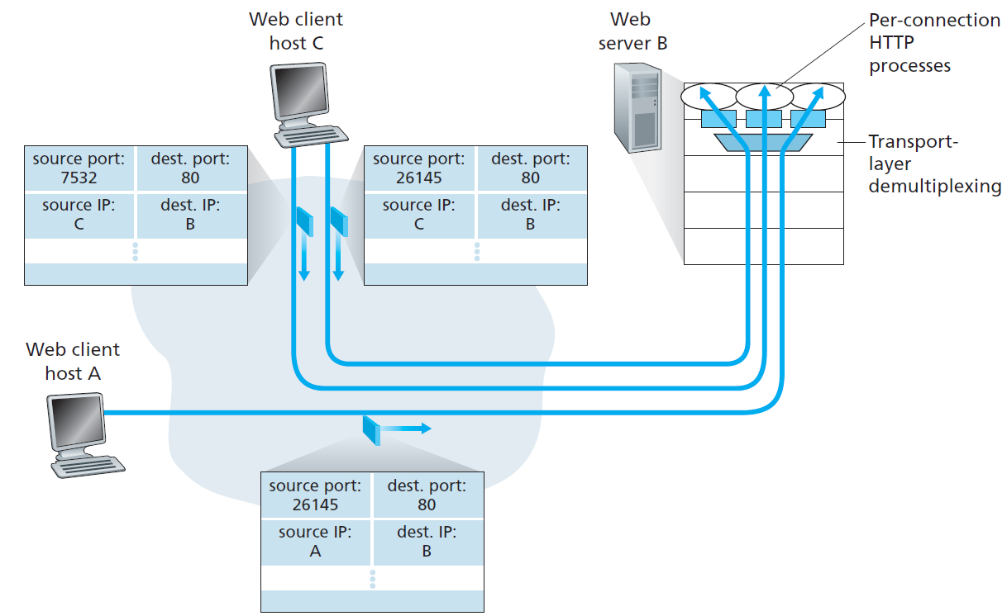
Connection-Oriented Multiplexing and Demultiplexing
Case for TCP
TCP socket is identified by four-tuple: (source IP, source port #, dest IP, dest port #)
Uses all four values to demultiplex segment to appropriate socket
Two arriving TCP segments with different source IP or port # will be directed to two different sockets
Host may support many simultaneous TCP connection sockets

Slide 15
Web Servers and TCP
Assume web server running on port 80
All segments sent by clients have destination port 80
Server distinguishes the segments from clients using source IP and source port #
Single process may have multiple sockets
Traditionally web server spawns new process per connection
Today, server use one process and create a new thread per connection
Persistent HTTP
Client and server use same socket for duration rather than new socket for each transaction

Slide 16
3.3 Connectionless Transport: UDP

Slide 17
About UDP
UDP does just about as little as a transport protocol can do
Only performs multiplexing/demultiplexing function and some light error checking
Connectionless protocol
No handshaking between sending and receiving transport-layer entities before sending a segment

Slide 18
UDP Scheme at Each Side
Sending host
UDP
Takes messages from the application process
Attaches source and destination port number, length, checksum fields
Passes resulting segment to network layer
Network layer
Encapsulates segment into IP datagram and then makes best-effort attempt of delivery
Receiving hosts
UDP
Uses the destination port number to deliver the segment’s data to the correct process

Slide 19
Reasons for Using UDP
Finer application-level control over what data is sent, and when
UDP packages the data inside a segment and immediately pass the segment to the network layer
No connection establishment
No handshakes therefore no delay
No connection state
Not maintain connection state and track any parameters
Small packet header overhead
Smaller header size(8 bytes) compared to TCP(20 bytes)
Example use case: DNS
Notes:
Finer application-level control??
Use case는 multimedia 쪽 = loss 수용이 가능하기 때문
근데, 논란도 많음
UDP는 congestion control이 되지 않으니까 TCP connection을 몰아냄

Slide 20
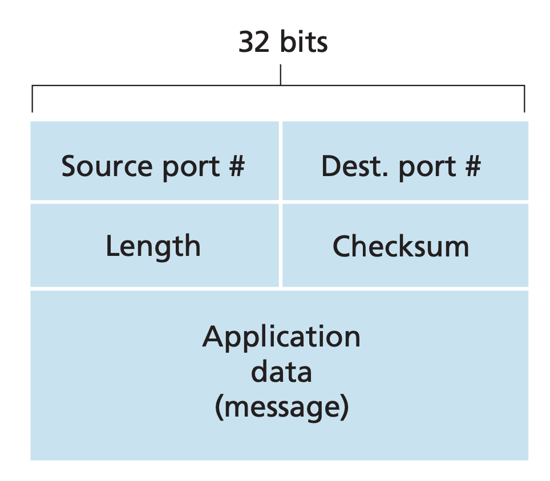
UDP Segment Structure
Header - 4 fields, 2 byte each
Source/Dest. port #
To pass application data to the correct process running on the end system
Length
Specifies the number of bytes in the UDP segment including header
Checksum
Provided to check whether errors have been introduced into the segment
Data
Application data occupies this field
Notes:
Source port – return address
Destination port – multiplexing
Length
Checksum – error checking
Data

Slide 21
UDP Checksum
Checksum is used to determine whether bits within the UDP segment have been altered during transmission
Checksum calculation
Performed by sender side
1s complement of the sum of all the 16-bit words in the segment
Overflow encountered during the sum being wrapped around
Checksum verification
Performed by receiving side
Sum all 16-bit words including the checksum
If result is 1111 1111 1111 1111: no error
Else: error occurred
Notes:
Segment를 16비트 단위로 쪼개서 그걸 전부 더함
Overflow되어서 carry되는 거 마지막에 더함
그리고 1의 보수 취함
* 1의 보수 취하는 이유는 checksum = 0과 구별하기 위해
(0은 checksum을 안 쓰겠다는 뜻이므로)

Slide 22
Reason Why UDP Provides Checksum Field
There is no guarantee that all the links between source and destination provide error checking
One of links may use no-error-checking link layer protocol
Also, it’s possible that bit errors could occur when a segment is stored in a router’s memory

Slide 23
3.4 Principles of Reliable Data Transfer

Slide 24
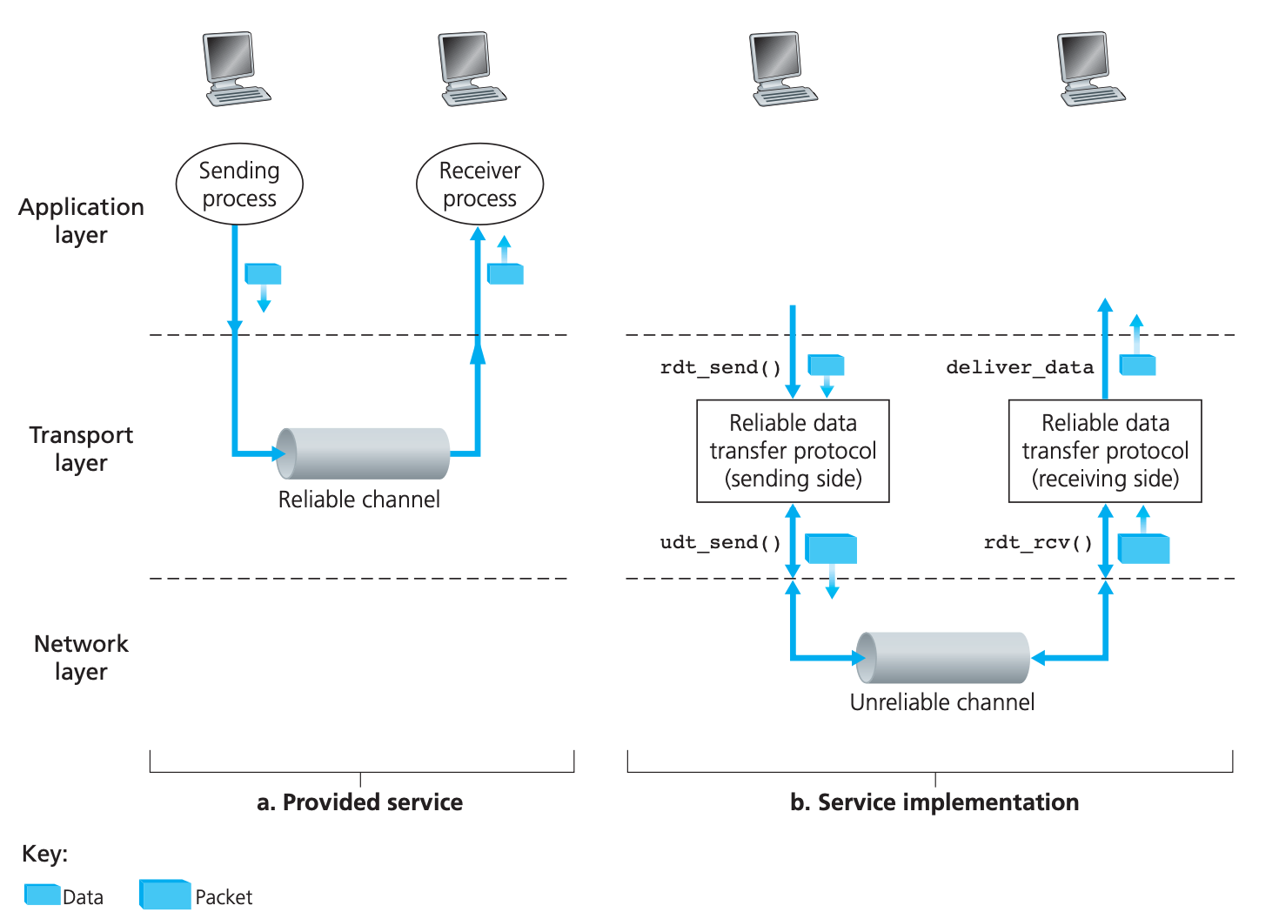
Principles of Reliable Data Transfer
Properties of reliable channel
No transferred data bits are corrupted or lost
All data are delivered in the order in which they were sent
Reliable data transfer protocol(rdt) implements reliable channel
Difficult because Layer below the rdt protocol may be unreliable

Slide 25
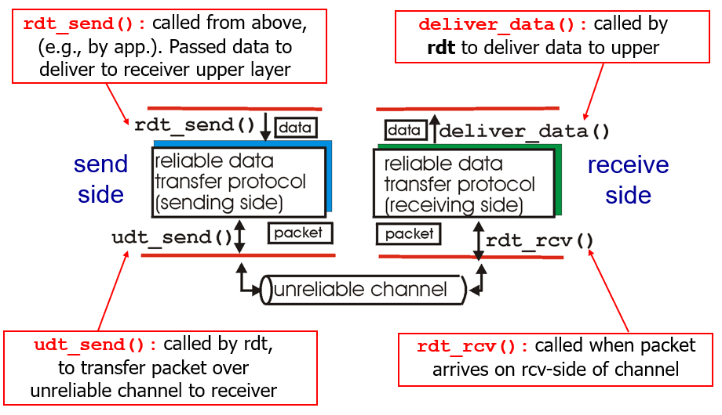
Assumptions and Definition of Functions
Assumptions
Packets will be delivered in order in which they were sent
It means, channel will not reorder packets
Some packet may get lost
Functions
rdt_send: Send data using rdt protocol
udt_send: Send packet data to channel
rdt_rcv: Receive packet from channel
deliver_data: Extract data form packet and deliver data to upper layer

Slide 26
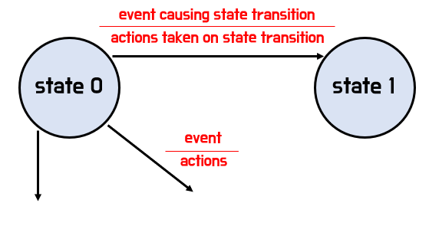
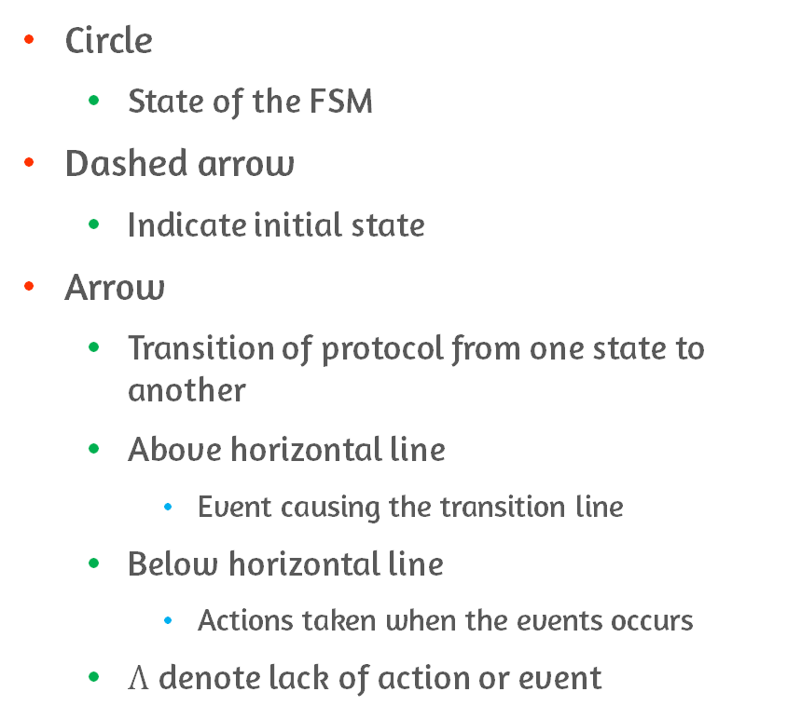
Definition and Terminology of Finite State Machine(FSM) Diagram
Circle
State of the FSM
Dashed arrow
Indicate initial state
Arrow
Transition of protocol from one state to another
Above horizontal line
Event causing the transition line
Below horizontal line
Actions taken when the events occurs
$Λ$ denote lack of action or event

Slide 27
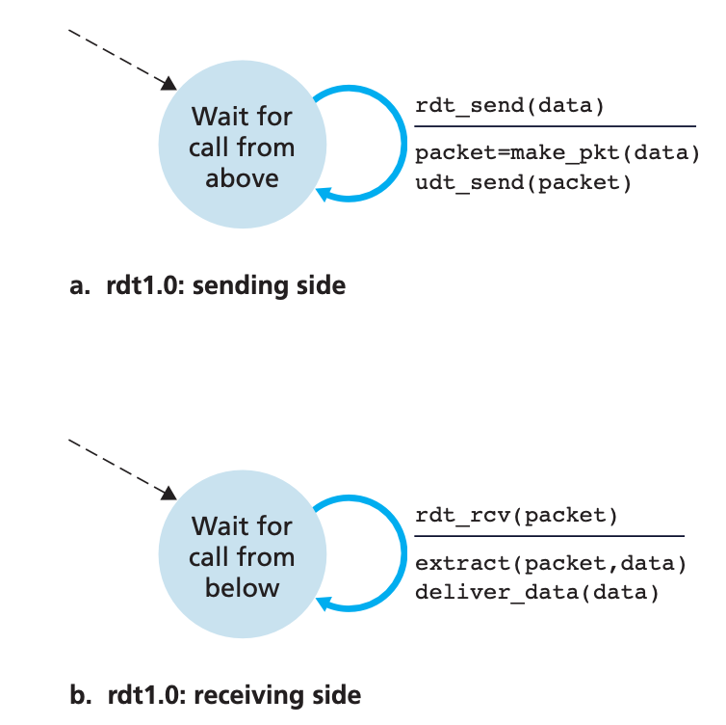
Reliable Data Transfer over a Perfectly Reliable Channel: rdt1.0
Separate FSMs for sender and receiver
Each have just one state
Sending side
Accepts data from the upper layer via rdt_send(data)
Creates a packet containing the data using make_pkt(data)
Sends the packet to channel udt_send(packet)
Receiving side
Receives a packet from the underlying channel via the rdt_rcv(packet)
Extract and pass data to upper layer
Notes:
패킷 손실도 없고, 비트 에러도 없음

Slide 28
Reliable Data Transfer over a Channel with Bit Errors: rdt2.0
Bit errors typically occur in network as a packet is transmitted, propagates, or is buffered
For these bit errors, employ error detection and ACKs
Positive ACK
It means, OK
And negative ACK
It means, please repeat that
Reliable data transfer based on retransmission is Automatic Repeat request(ARQ) protocol

Slide 29
Capabilities in ARQ
Error detection
Receiver should be able to detect bit errors within the segment(checksum)
Receiver feedback
Receiver should provide explicit feedback to sender(sending ACK/NAK)
Retransmission
Packet that is received in error should be retransmitted by the sender

Slide 30
Reliable Data Transfer over a Channel with Bit Errors: rdt2.0 - ARQ
Bit errors typically occur in network as a packet is transmitted, propagates, or is buffered
Implements Automatic Repeat reQuest (ARQ) protocol
Uses positive / negative acknowledgments (ACK / NAK) to let the sender know whether error has occurred or not
Requirements for implementing ARQ protocol
Error detection
Receiver should be able to detect bit errors within the segment(checksum)
Receiver feedback
Receiver should provide explicit feedback to sender(sending ACK/NAK)
Retransmission
Packet that is received in error should be retransmitted by the sender

Slide 31
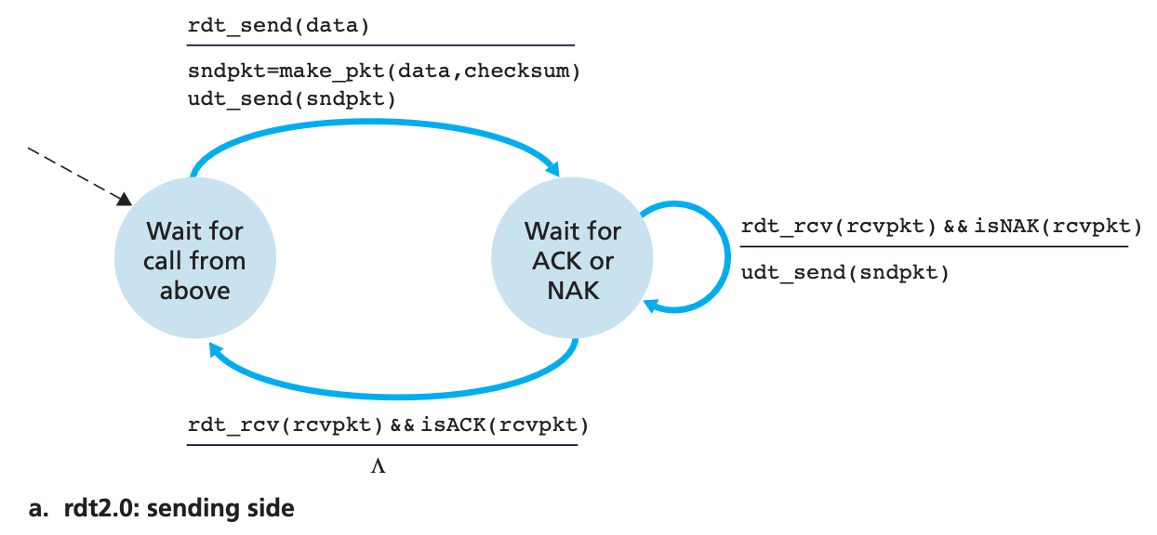
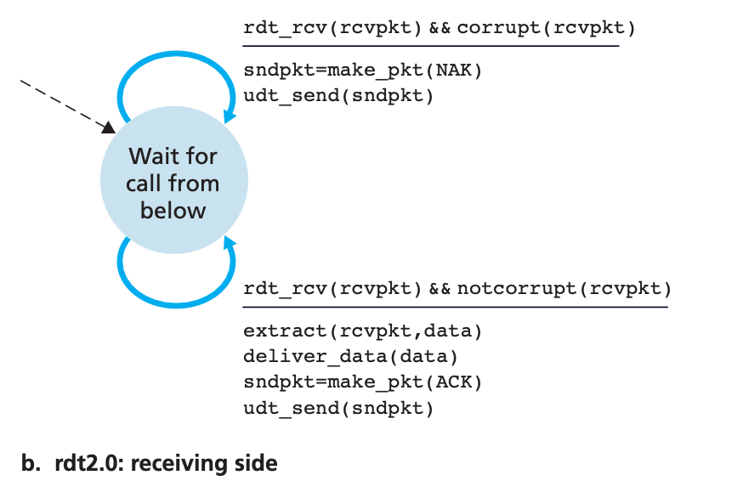
Reliable Data Transfer over a Channel with Bit Errors: rdt2.0
Sending side
Creak packet when rdt_send(data) occurs
Send packet via udt_send(sndpkt)
After sending, transit state and wait for ACK/NAK
If ACK is received transit state
If NCK is received retransmit and stay in current state
So, called stop-and-wait protocol
Receiving side
On packet arrival, receiver checks and replies with either an ACK or a NAK
Notes:
에러가 있는 경우
에러가 없는 경우
나누어서 설명

Slide 32
Problems of rdt2.0
rdt2.0 have possibility that ACK/NAK packet can be corrupted
Mitigation methods for corrupted ACK/NAK
Minimally, add enough checksum to recover error
Sender simply to resend the current data packet on corrupted ACK/NAK
Duplicate packets happens, but solvable by adding sequence numbers

Slide 33
Reliable Data Transfer over a Channel with Bit Errors: rdt2.1 - Properties
Mitigation of rdt2.0 by adding sequence number
Sender puts sequence # in packet
Receiver checks sequence # to check whether packet is new or retransmission
For simple case of stop-and-wait protocol, 1-bit sequence # is suffice
Use both positive and negative ACKs from receiver to sender
For out-of-order packet, receiver send positive ACK for the last received packet
For corrupted packet, receiver send negative ACK
Notes:
NAK-free는 duplicate ACK으로 대체 가능한데

Slide 34
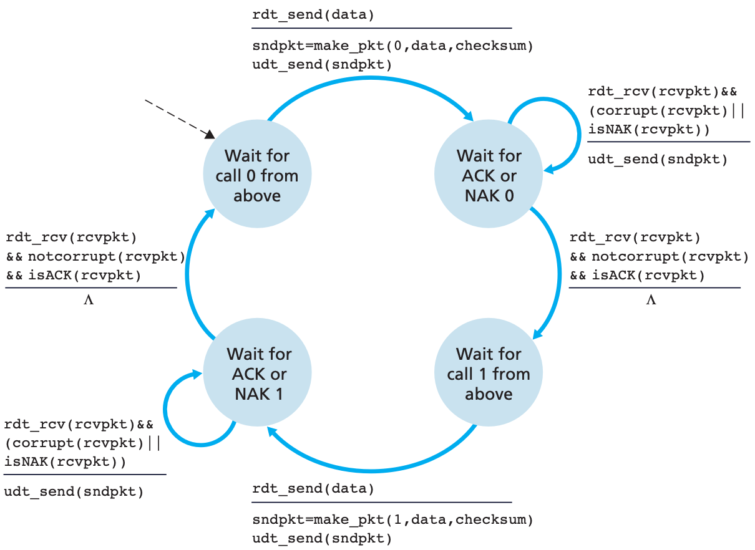
Reliable Data Transfer over a Channel with Bit Errors: rdt2.1 - Sending side
Create packet including sequence number when rdt_send(data) occurs
Send packet via udt_send(sndpkt)
After transmission, transit state wait for ACK/NAK
If ACK is received, proceed to next sequence number
If NAK is received, retransmit packet and check for ACK/NAK

Slide 35
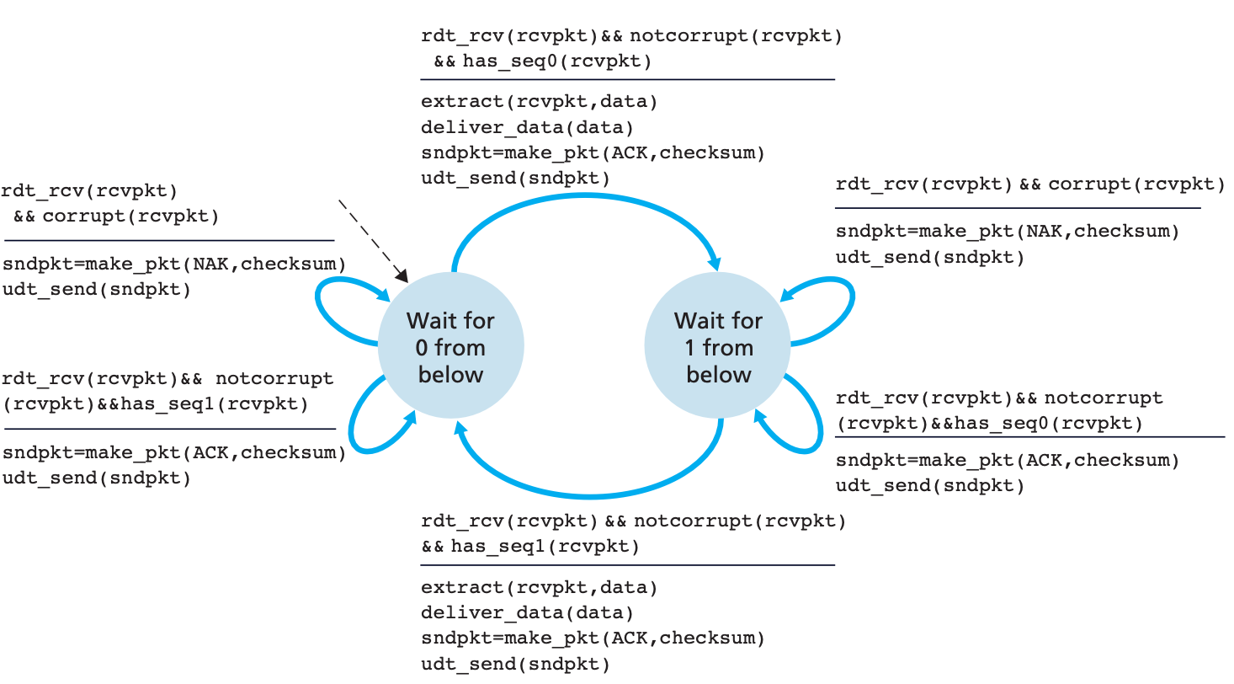
Reliable Data Transfer over a Channel with Bit Errors: rdt2.1 - Receiving side
Uses both positive and negative acknowledgments from the receiver to the sender
When a corrupted packet is received, send NAK
When an out-of-order packet is received, send ACK
Check packet’s sequence number before transiting to other state

Slide 36
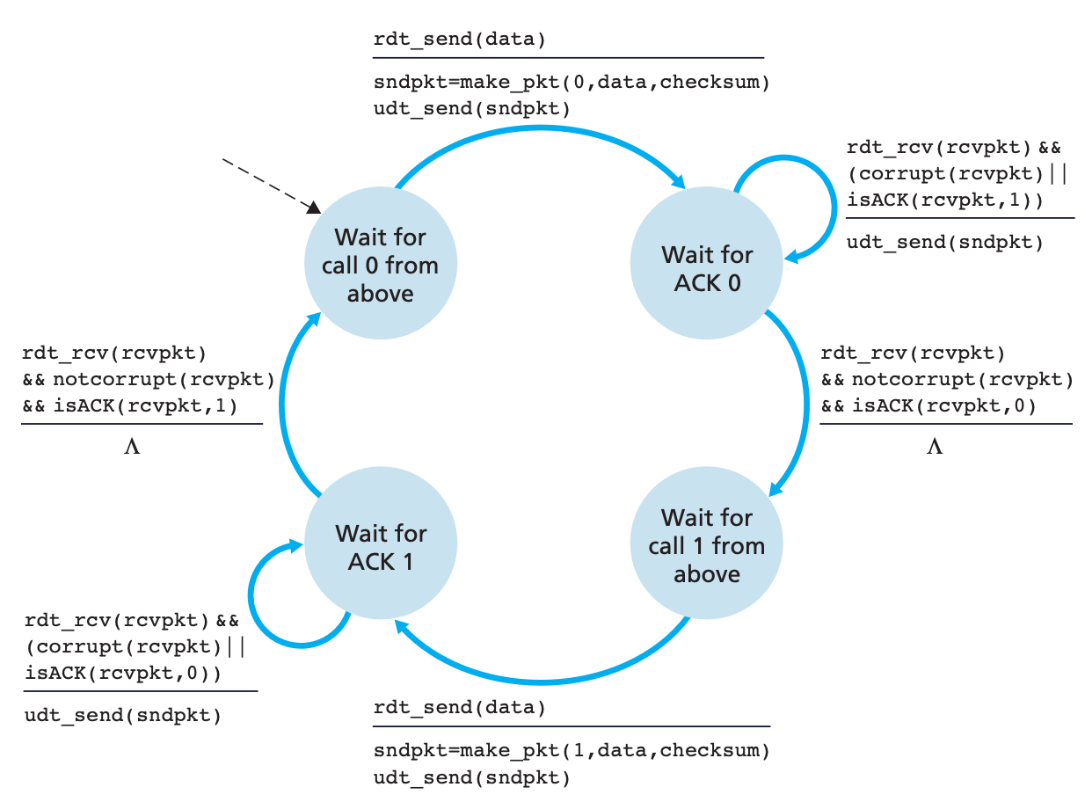
Reliable Data Transfer over a Channel with Bit Errors: rdt2.2 - Sending side
Instead of using NAK, rdt2.2 implements ACKs with sequence number
Sender must now check the sequence number of the packet being acknowledged by a received ACK message

Slide 37
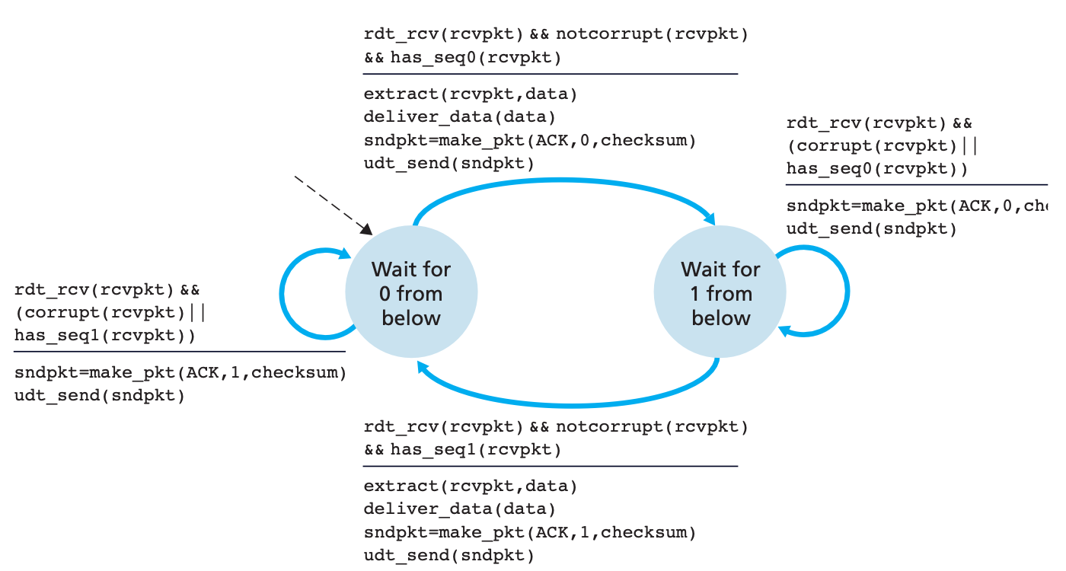
Reliable Data Transfer over a Channel with Bit Errors: rdt2.2 - Receiving side
Include the sequence number of the packet being acknowledged to ACK
Delete NAK
What if packet is lost?
Rdt3.0

Slide 38
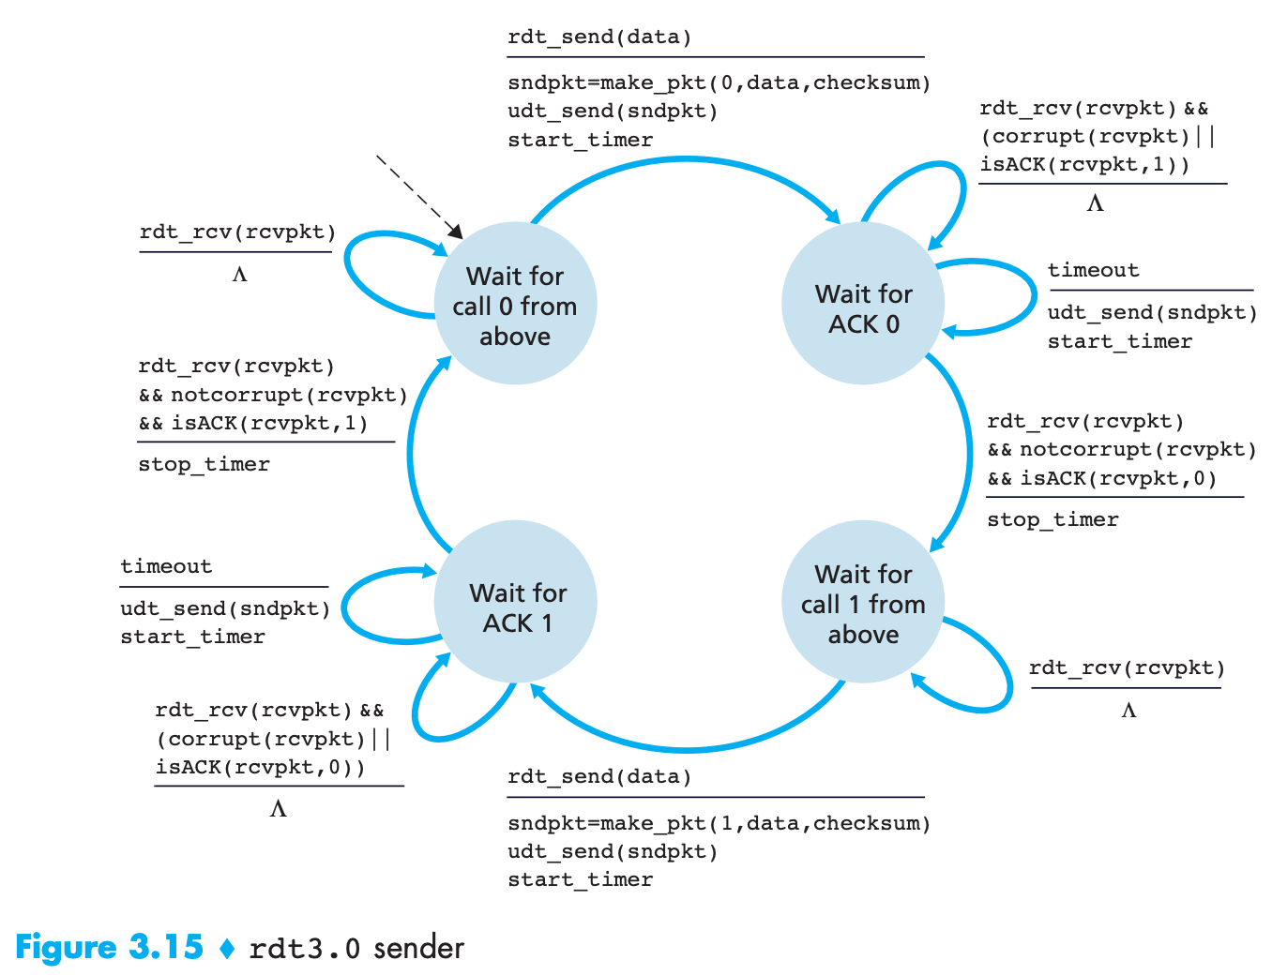
Reliable Data Transfer over a Lossy Channel with Bit Errors: rdt3.0
Added timer for time-based retransmission to mitigate packet loss
If an ACK is not received within certain time, the packet is retransmitted
Since sender does not know whether packet was lost, ACK was lost, or if the packet or ACK was delayed
Scheme
Start the timer each time a packet is sent
Respond to a timer interrupt
Retransmission
Stop the timer

Slide 39
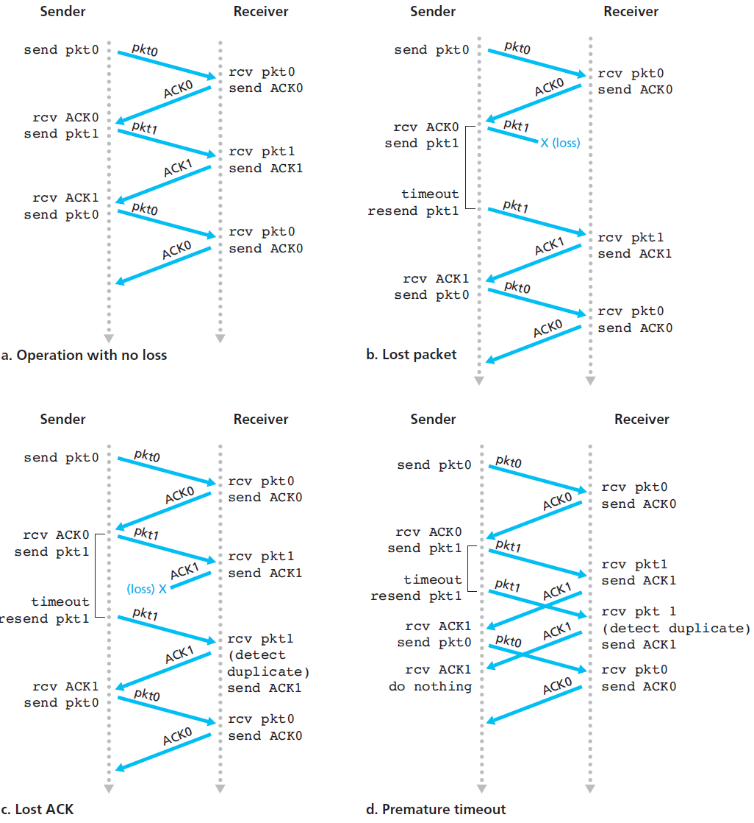
Reliable Data Transfer over a Lossy Channel with Bit Errors: rdt3.0 #2

Slide 40
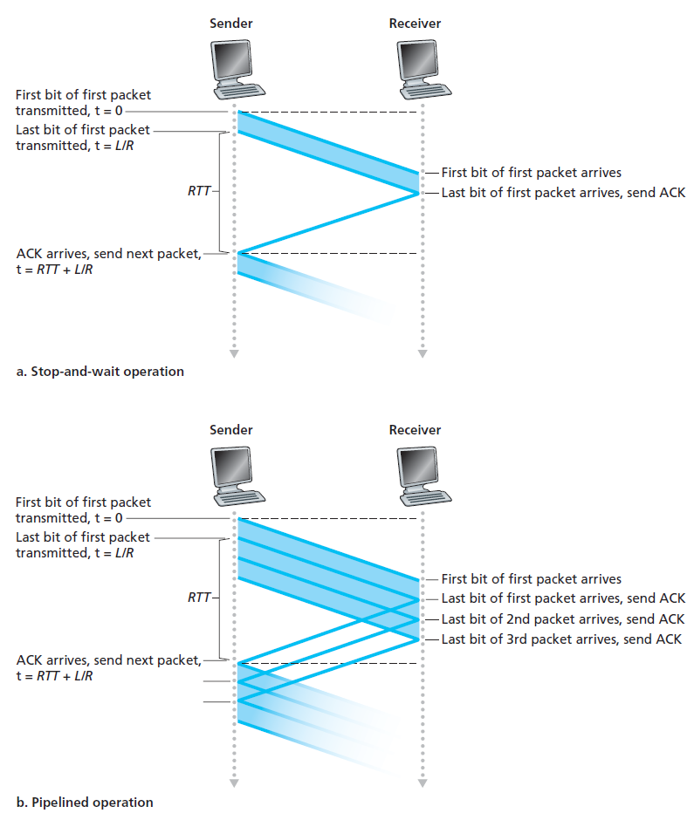
Pipelined Reliable Data Transfer Protocols
Performance problem with stop-and-wait protocols
Low utilization of the channel because of waiting
Pipelining
Allow sender to send multiple packets rather than waiting for ACKs
Consequences of pipelining in RDT
Range of seq. # should be increased
Unique identifier for packets on the fly
Sender or receiver side may have to buffer more than one packet(E.g., packet not ACKed)
Change in error recovery methods
Go-Back-N / Selectice repeat

Slide 41
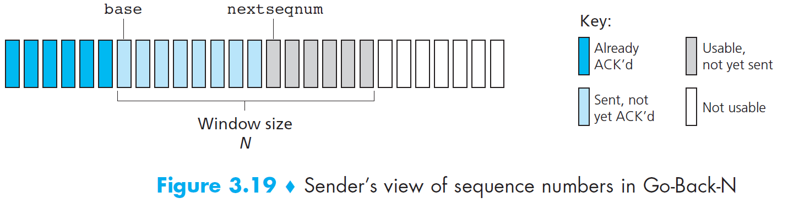
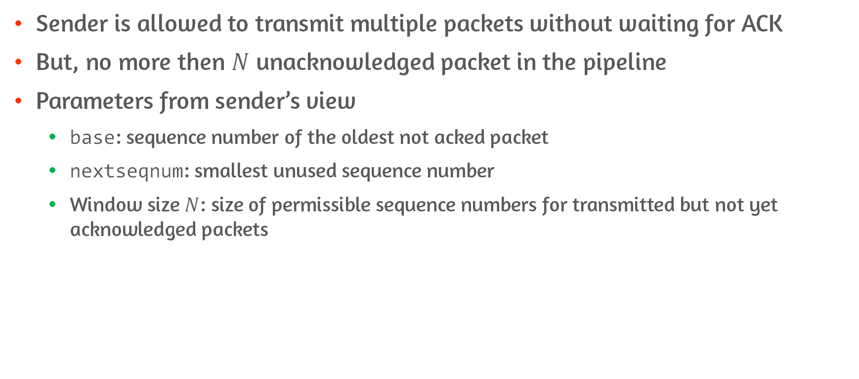
Go-Back-N (GBN)
Sender is allowed to transmit multiple packets without waiting for ACK
But, no more then $N$ unacknowledged packet in the pipeline
Parameters from sender’s view
base: sequence number of the oldest not acked packet
nextseqnum: smallest unused sequence number
Window size $N$: size of permissible sequence numbers for transmitted but not yet acknowledged packets

Slide 42
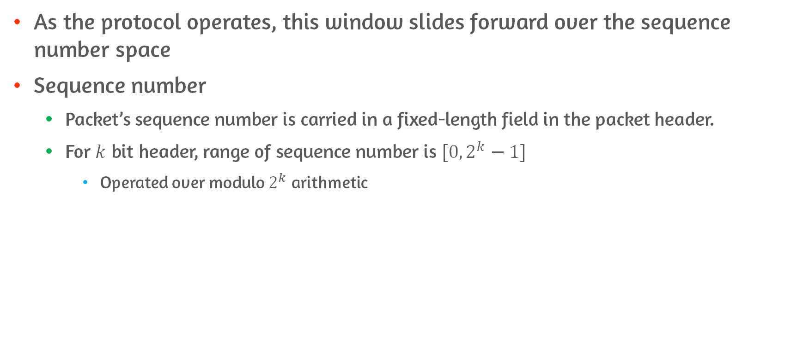
Go-Back-N (GBN): Sliding-Window Protocol
As the protocol operates, this window slides forward over the sequence number space
Sequence number
Packet’s sequence number is carried in a fixed-length field in the packet header.
For $k$ bit header, range of sequence number is $[0, 2^{k}−1]$
Operated over modulo $2^{k}$ arithmetic

Slide 43
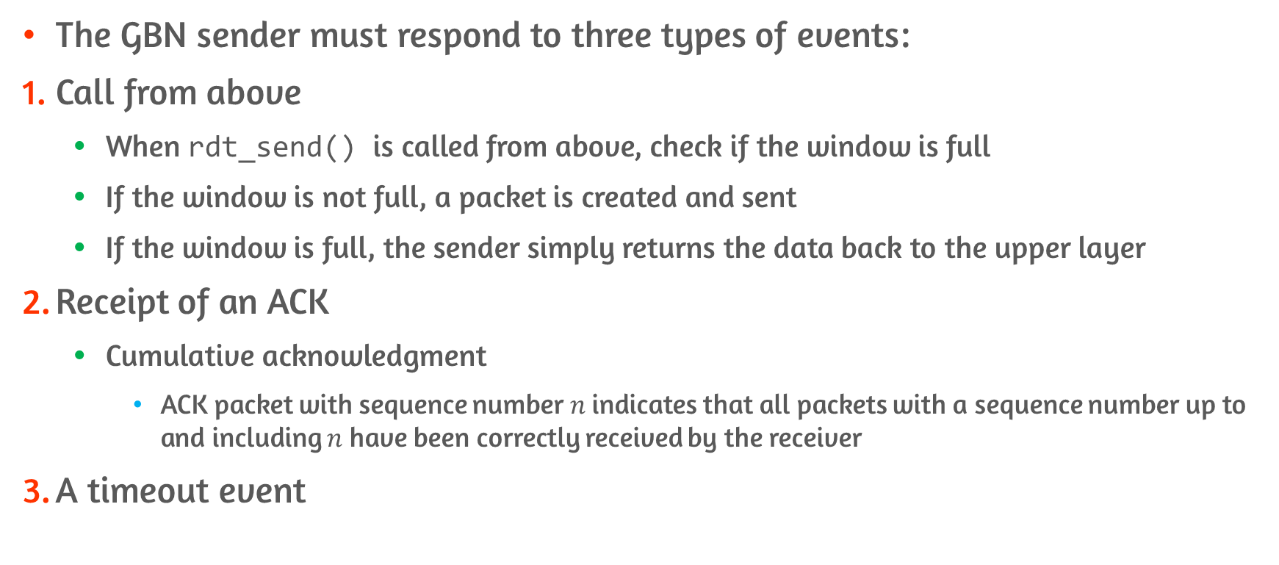
Go-Back-N (GBN): Sender #1
The GBN sender must respond to three types of events:
Call from above
When rdt_send() is called from above, check if the window is full
If the window is not full, a packet is created and sent
If the window is full, the sender simply returns the data back to the upper layer
Receipt of an ACK
Cumulative acknowledgment
ACK packet with sequence number $n$ indicates that all packets with a sequence number up to and including $n$ have been correctly received by the receiver
A timeout event

Slide 44
Go-Back-N (GBN): Sender #2
Continued
A timeout event
If timeout occurs, resend all packets that have been sent but not yet been acknowledged
If ACK is received but additional transmitted but not yet ACKed packets exists timer is restarted
If there are no ACKs to be received timer is stopped
Typically implemented with single timer

Slide 45
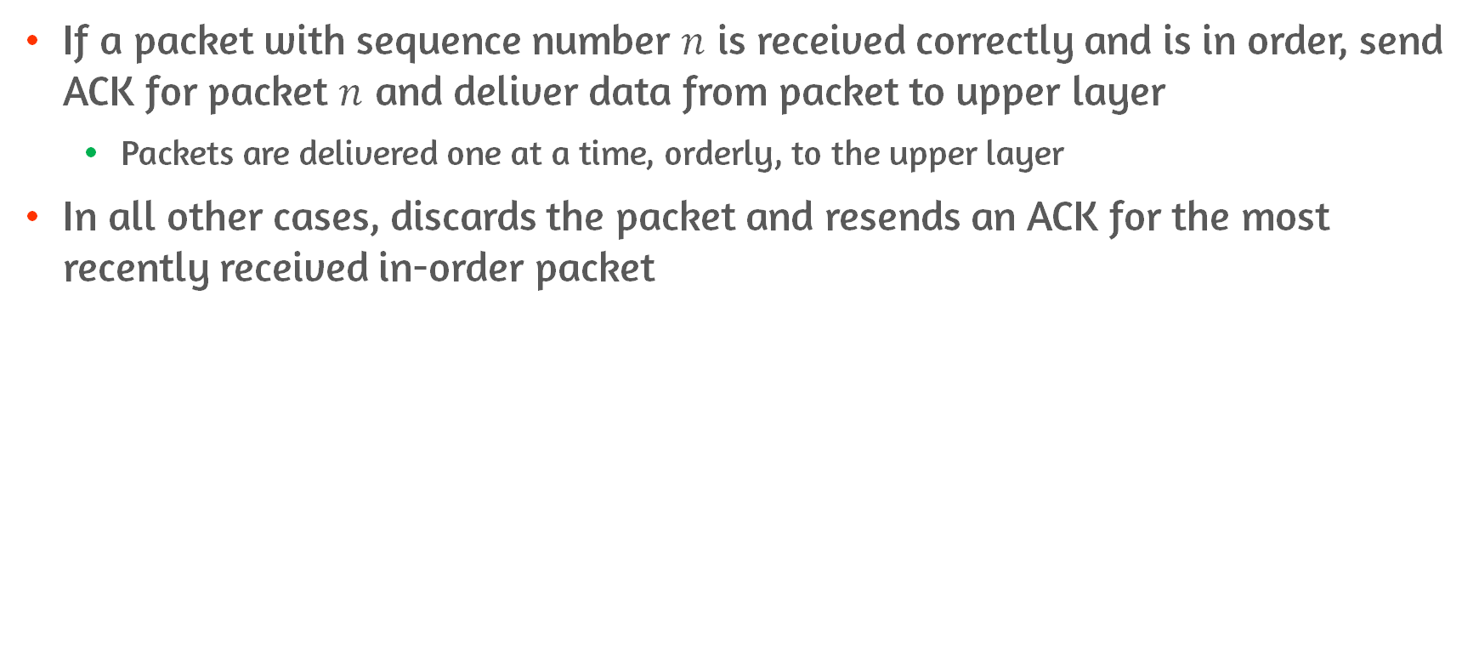
Go-Back-N (GBN): Receiver
If a packet with sequence number $n$ is received correctly and is in order, send ACK for packet $n$ and deliver data from packet to upper layer
Packets are delivered one at a time, orderly, to the upper layer
In all other cases, discards the packet and resends an ACK for the most recently received in-order packet

Slide 46
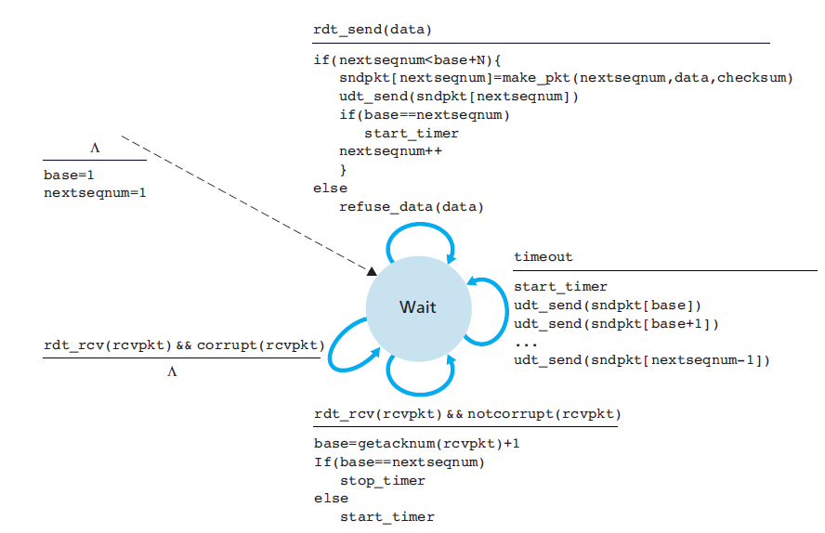
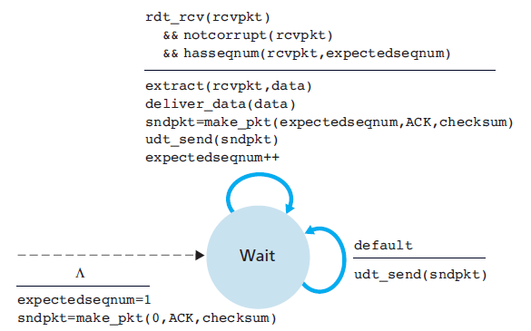
Extended FSM for GBN
Sender
Reciever

Slide 47
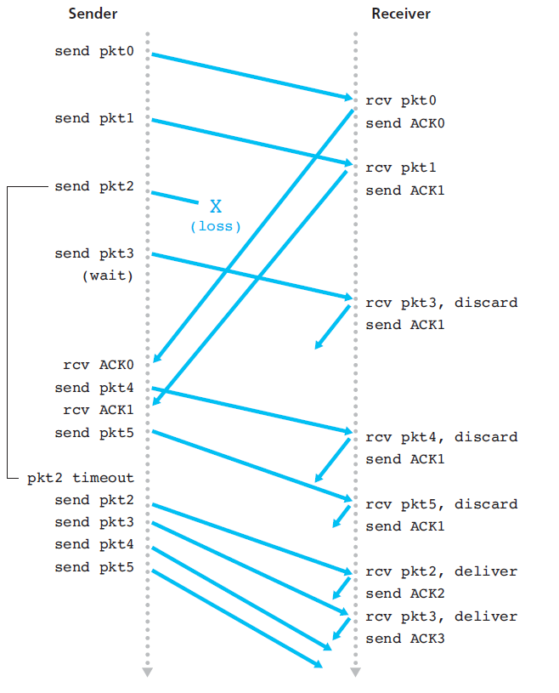
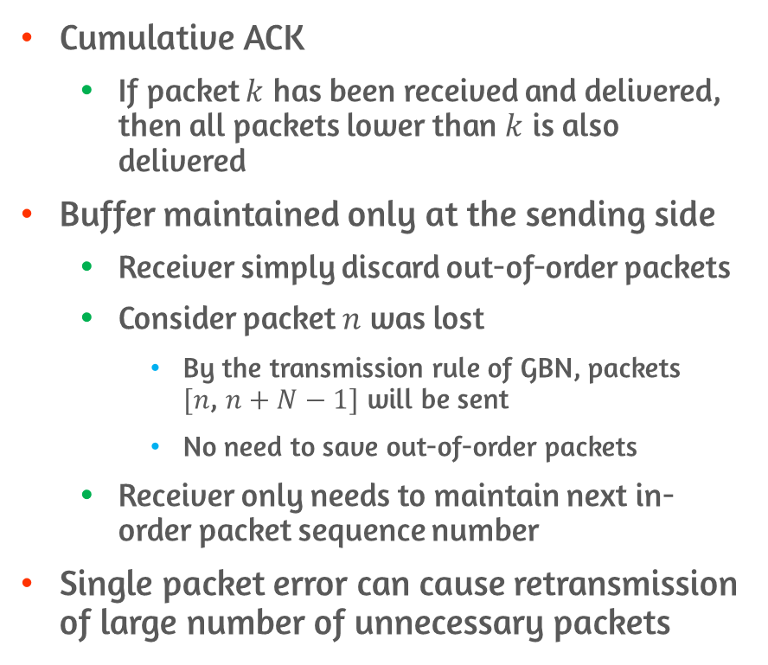
Characteristics of GBN
Cumulative ACK
If packet $k$ has been received and delivered, then all packets lower than $k$ is also delivered
Buffer maintained only at the sending side
Receiver simply discard out-of-order packets
Consider packet $n$ was lost
By the transmission rule of GBN, packets $[n$, $n+N−1]$ will be sent
No need to save out-of-order packets
Receiver only needs to maintain next in-order packet sequence number
Single packet error can cause retransmission of large number of unnecessary packets

Slide 48
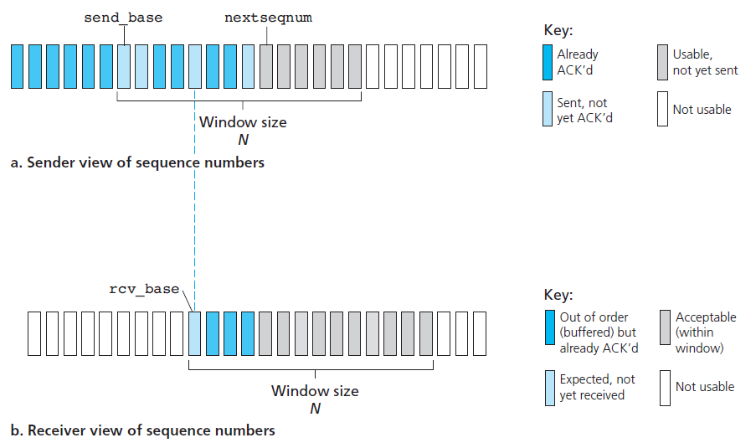
Selective Repeat (SR)
SR avoid unnecessary retransmissions
Sender retransmits packet that were received in error
Requires receiver to individually acknowledge correctly received packet
Out-of-order packets are buffered until missing packets are received
Batch of packets will be delivered to upper-layer at some point

Slide 49
Selective Repeat (SR): Sender Events and Actions #1
Data received from above
For received data, check next available sequence number for the packet
If sequence number is within sender’s window, packetize data and send packet
Otherwise send back to upper layer
Timeout
Each packet has its’ own timer
Only a single packet is retransmitted on timeout
ACK received

Slide 50
Selective Repeat (SR): Sender Events and Actions #2
Continued
ACK received
If ACK is received, mark that packet as received
If sequence number is equal to send_base, window base is moved forward
To smallest unACKed seq. #

Slide 51
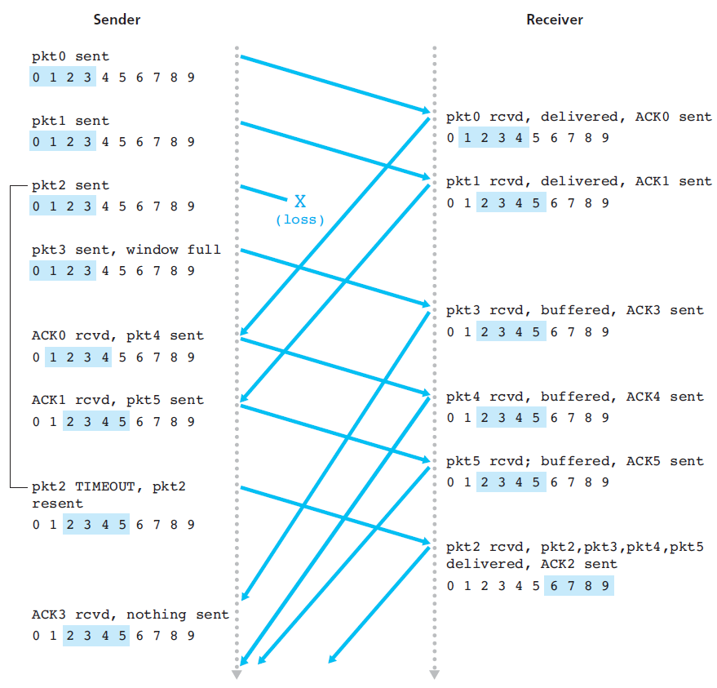
Selective Repeat (SR): Receiver Events and Actions
Packet with sequence number in [rcv_base, rcv_base+N-1] is correctly received
Selective ACK packet is returned to sender
If the packet was not previously received, it is buffered
If seq # == rcv_base, consecutively numbered packets are delivered to the upper layer
Packet with sequence number in [rcv_base-N, rcv_base-1] is correctly received
ACK must be generated, even though this packet has been acknowledged
Otherwise, ignore the packet

Slide 52
3.5 Connection-Oriented Transport: TCP

Slide 53
Characteristics TCP Connection
Connection-oriented
Two processes must first handshake with each other before sending data
Sending preliminary segments to establish parameters
Three-way handshake
TCP protocol runs only in the end systems
Intermediate network connections doesn’t maintain TCP connection state
TCP provides full-duplex service
TCP connection is always point-to-point, no multicasting

Slide 54
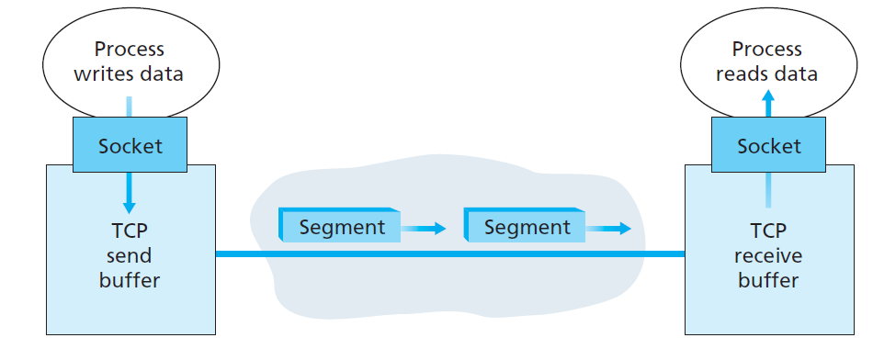
Sending Data With TCP: Client to Server - Client Side
Client process passes a stream of data through TCP socket
TCP directs this data to the connection’s send buffer
TCP grabs chunks of data from buffer and pass the data to the network layer
Size limited by maximum segment size(MSS)
Form TCP segments by paring TCP header with each chunk
Segment passed down to network-layer
Separately encapsulated within network-layer IP datagrams

Slide 55
Sending Data With TCP: Client to Server - Server Side
On segment received, segment’s data is placed in the TCP connection’s receive buffer
Each side of the connection has its own send buffer and its own receive buffer

Slide 56
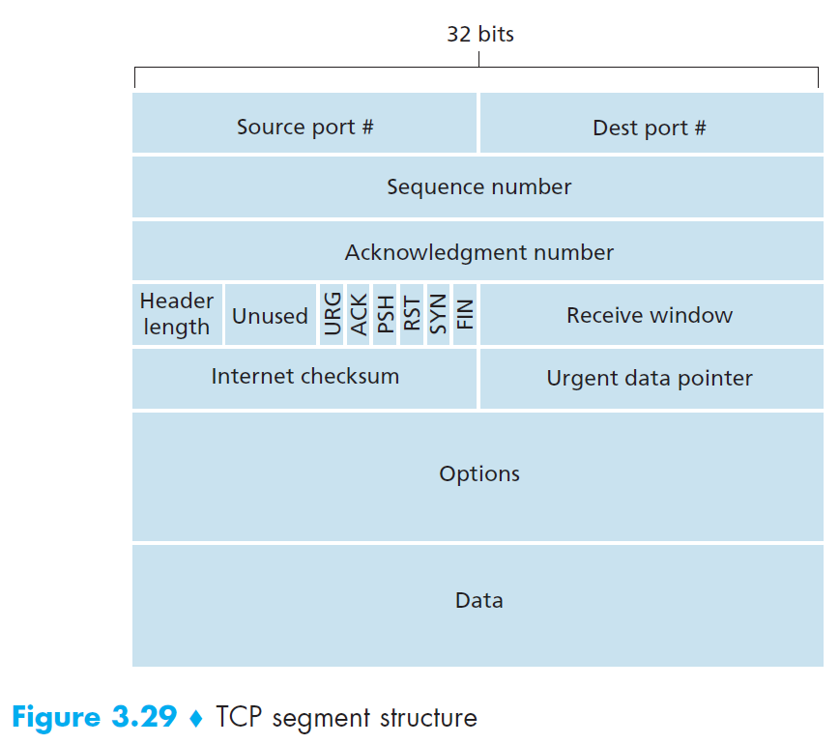
TCP Segment Header Structure
Source / Destination port numbers fields
Used for muxing/demuxing data from/to upper-layer applications
Checksum field
Seq. # field and ACK # fields
Used for reliable data transfer service
Receive window field
Use for flow control
Header length field
Represents variable length of TCP header due to TCP option fields
Options field
Used for negotiating MMS or window scaling factor

Slide 57
Sequence Numbers and Acknowledgment Numbers
Sequence number
Byte-stream number of the first byte in the segment
E.g., Suppose 500,000 byte file transfer with MMS of 1,000 bytes
Seq # = 0, 1000, 2000, 3000, …
Acknowledgment number
Sequence number of the next byte receiving host is expecting from the opponent
Provides cumulative acknowledgments
E.g., Host A received 0~535 bytes from host B
A’s next segment to B will contain 536 in the acknowledgment number field

Slide 58
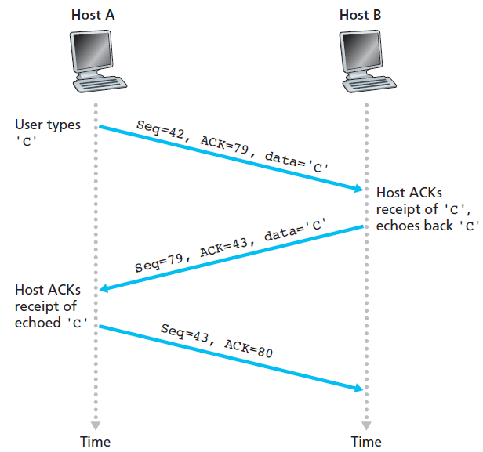
Telnet: A Case Study for Sequence and Acknowledgment Numbers #1
Telnet
Popular application-layer protocol used for remote login
Runs over TCP
Host A(client) initiates Telnet session with host B(server)
Starting sequence numbers are 42 and 79 for the client and server
User types ‘C’
Initial value 42 is sent for Seq
Since, ACK number is the sequence number of the next byte that host is waiting for 79 is sent for ACK

Slide 59
Telnet: A Case Study for Sequence and Acknowledgment Numbers #2
Server replies data
Since, client is waiting for sequence number of 79(received ACK from client), send 79 for Seq
Since, sequence number of 42 is received, 43 is sent back to A
Acknowledgment is said to be piggybacked on the segment
Client sends ACK
Seq=43, ACK=80

Slide 60
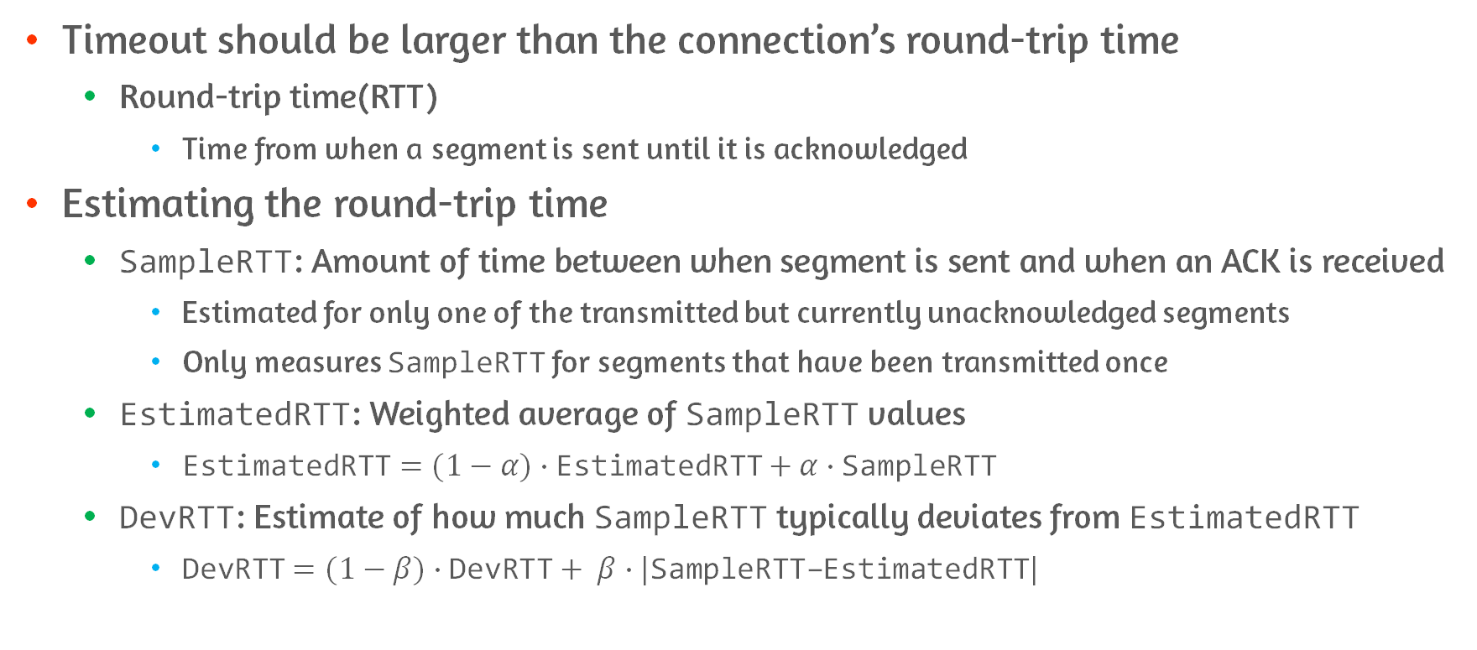
Round-Trip Time Estimation and Timeout
Timeout should be larger than the connection’s round-trip time
Round-trip time(RTT)
Time from when a segment is sent until it is acknowledged
Estimating the round-trip time
SampleRTT: Amount of time between when segment is sent and when an ACK is received
Estimated for only one of the transmitted but currently unacknowledged segments
Only measures SampleRTT for segments that have been transmitted once
EstimatedRTT: Weighted average of SampleRTT values
EstimatedRTT$=(1−α)∙\text{EstimatedRTT}$ $+ α∙\text{SampleRTT}$
DevRTT: Estimate of how much SampleRTT typically deviates from EstimatedRTT
DevRTT$=(1−β)∙\text{DevRTT}+ β∙|\text{SampleRTT}\text{−}$EstimatedRTT$|$

Slide 61
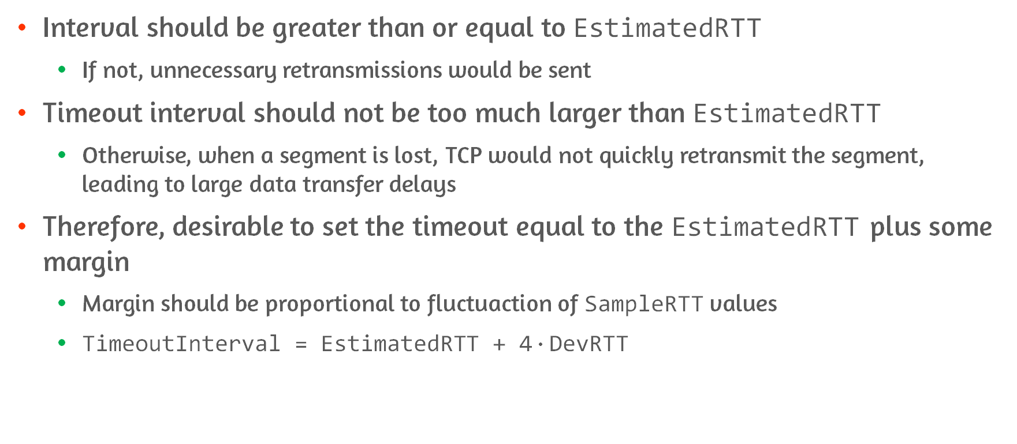
Setting and Managing the Retransmission Timeout Interval
Interval should be greater than or equal to EstimatedRTT
If not, unnecessary retransmissions would be sent
Timeout interval should not be too much larger than EstimatedRTT
Otherwise, when a segment is lost, TCP would not quickly retransmit the segment, leading to large data transfer delays
Therefore, desirable to set the timeout equal to the EstimatedRTT plus some margin
Margin should be proportional to fluctuaction of SampleRTT values
TimeoutInterval = EstimatedRTT + 4$∙$DevRTT

Slide 62
Reliable Data Transfer
TCP creates a reliable data transfer service on top of IP’s unreliable best effort service
Ensures that the data stream out of TCP receive buffer is uncorrupted, without gaps, without duplication, and in sequence
It is recommended to use single retransmission timer
To reduce timer management overhead

Slide 63
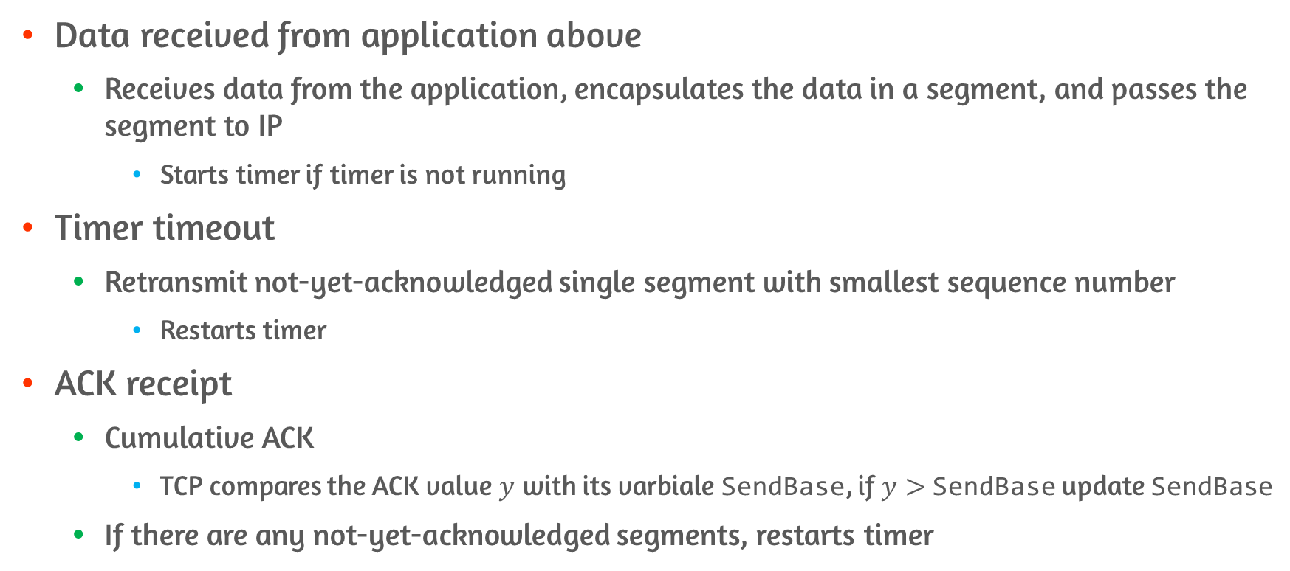
Three major events in data transmission and retransmission
Data received from application above
Receives data from the application, encapsulates the data in a segment, and passes the segment to IP
Starts timer if timer is not running
Timer timeout
Retransmit not-yet-acknowledged single segment with smallest sequence number
Restarts timer
ACK receipt
Cumulative ACK
TCP compares the ACK value $y$ with its varbiale SendBase, if $y>$SendBase update SendBase
If there are any not-yet-acknowledged segments, restarts timer

Slide 64
Doubling the Timeout Interval
TCP sets the next timeout interval to twice the previous value
However, whenever the timer is started after other events, timeout interval is derived from most recent value of EstimatedRTT and DevRTT
Timer expiration is most likely caused by congestion in the network
In times of congestion, if the sources continue to retransmit packets persistently, the congestion may get worse

Slide 65
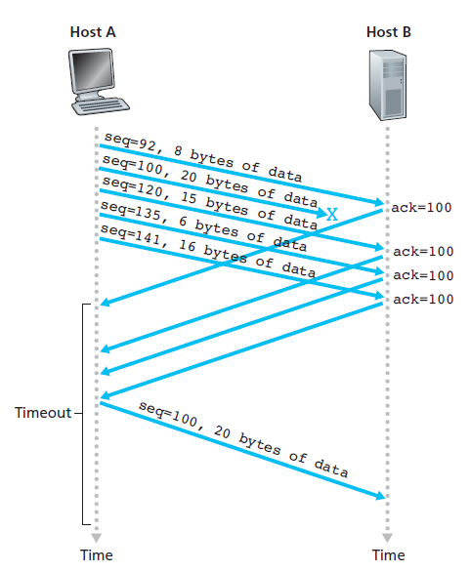
Fast Retransmit
Timeout period can be relatively long for timeout-triggered retransmissions
If segment is lost, long timeout period forces sender to delay resending of lost packets
Sender can detect packet loss by duplicate ACK
Duplicate ACK: ACK that re-acknowledges a segment that sender has already received
If three duplicate ACKs, sender performs fast retransmit
Retransmitting the missing segment before that segment’s timer expires

Slide 66
Go-Back-N or Selective Repeat?
Similarities with GBN
Cumulative ACK
Simple ACK and window tracking on sender side
Major difference with GBN
TCP would retransmit at most one segment while GBN retransmits whole window
Selective acknowledgment
Modification to TCP
Allows a TCP receiver to acknowledge out-of-order segments selectively
Hybrid of GBN and SR protocols

Slide 67
Flow Control
Flow control is speed-matching service
Matching the rate at which the sender is sending against the rate at which the receiving application is reading
TCP provides a flow-control service to its applications to eliminate the possibility of the sender overflowing the receiver’s buffer
TCP provides flow control by having the sender maintain a variable called the receive window
Used inform sender free buffer space available at the receiver

Slide 68
Flow Control – Example #1
Suppose that Host A is sending a large file to host B over a TCP
Definitions
RcvBuffer
Size of host B’s receive buffer
LastByteRead
Number of the last byte in the data stream read from the buffer by the application process in B
LastByteRcvd
Number of the last byte in the data stream that has arrived from the network and has been placed in the receive buffer at B
Receive window(rwnd)
Amount of spare room in the buffer

Slide 69
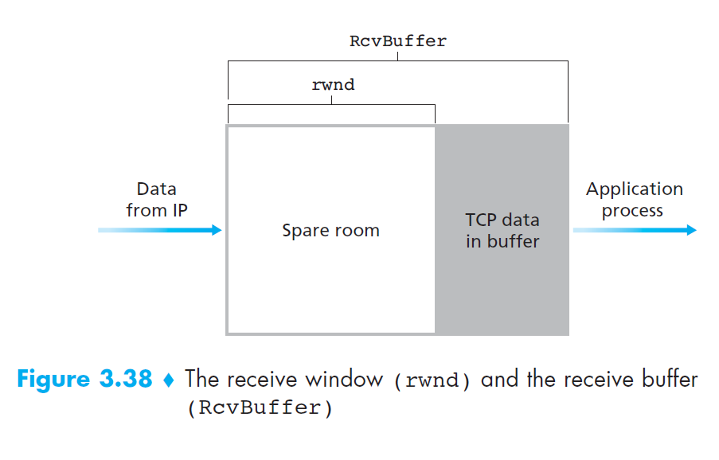
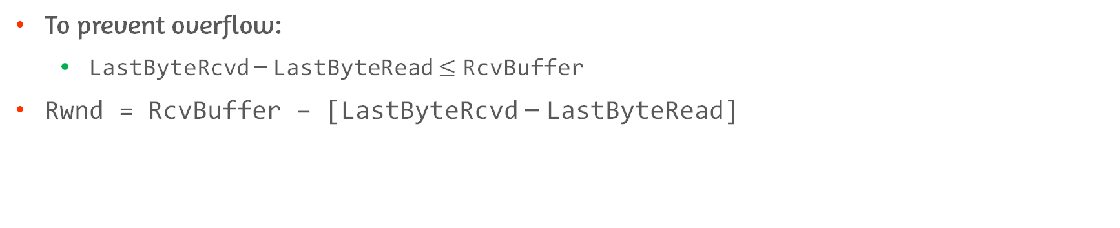
Flow Control – Example #2
To prevent overflow:
LastByteRcvd – LastByteRead $≤$ RcvBuffer
Rwnd = RcvBuffer – [LastByteRcvd – LastByteRead]

Slide 70
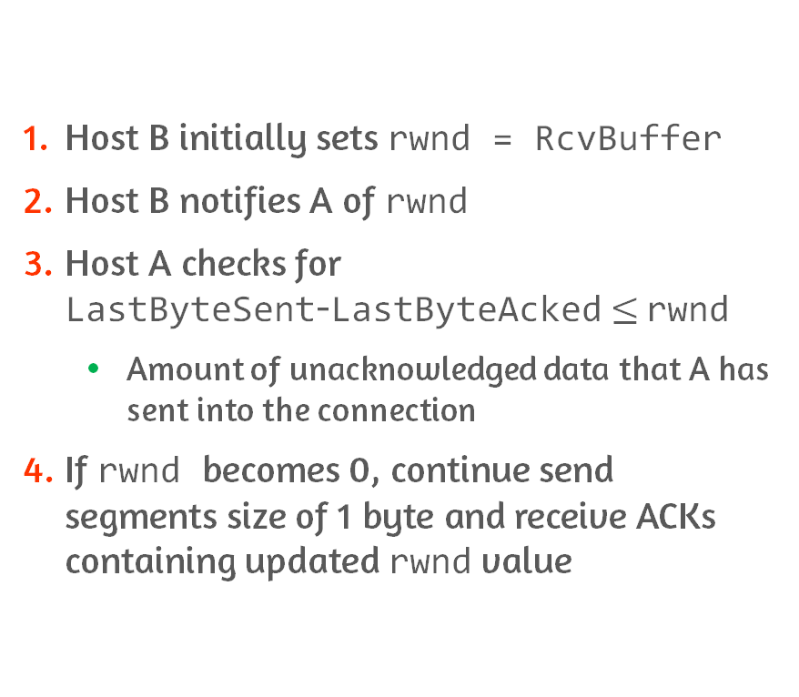
Flow Control – Example #3
Host B initially sets rwnd = RcvBuffer
Host B notifies A of rwnd
Host A checks for LastByteSent-LastByteAcked$≤$ rwnd
Amount of unacknowledged data that A has sent into the connection
If rwnd becomes 0, continue send segments size of 1 byte and receive ACKs containing updated rwnd value

Slide 71
3.6 Principles of Congestion Control

Slide 72
Congestion Control
Loss results from overflowing of router buffers as the network becomes congested
Packet retransmission treats loss of segment
However, does not treat the cause of network congestion
So, throttle senders in the face of network congestion

Slide 73
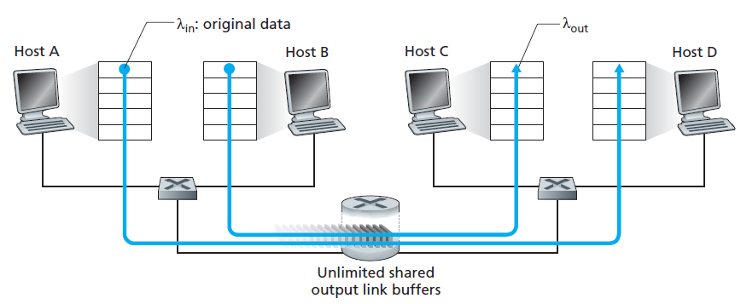
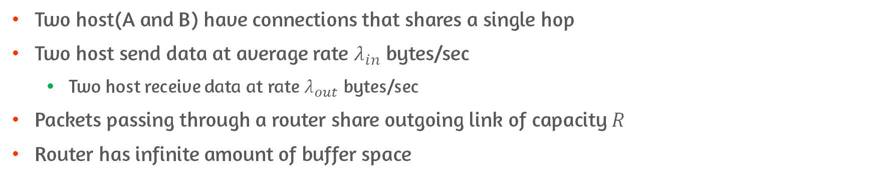
Scenario 1: Two Senders, Router with Infinite Buffers
Two host(A and B) have connections that shares a single hop
Two host send data at average rate $λ_{in}$ bytes/sec
Two host receive data at rate $λ_{out}$ bytes/sec
Packets passing through a router share outgoing link of capacity $R$
Router has infinite amount of buffer space
Notes:
시나리오에서 다루는 건 1) congestion이 왜 발생하는가 2) cost of congestion (utilization과 performance 관점)

Slide 74
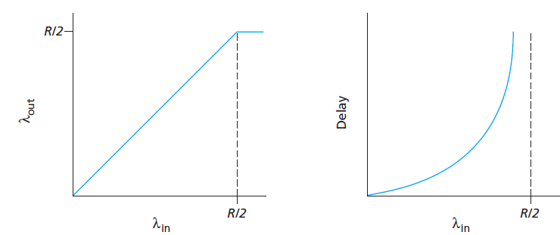
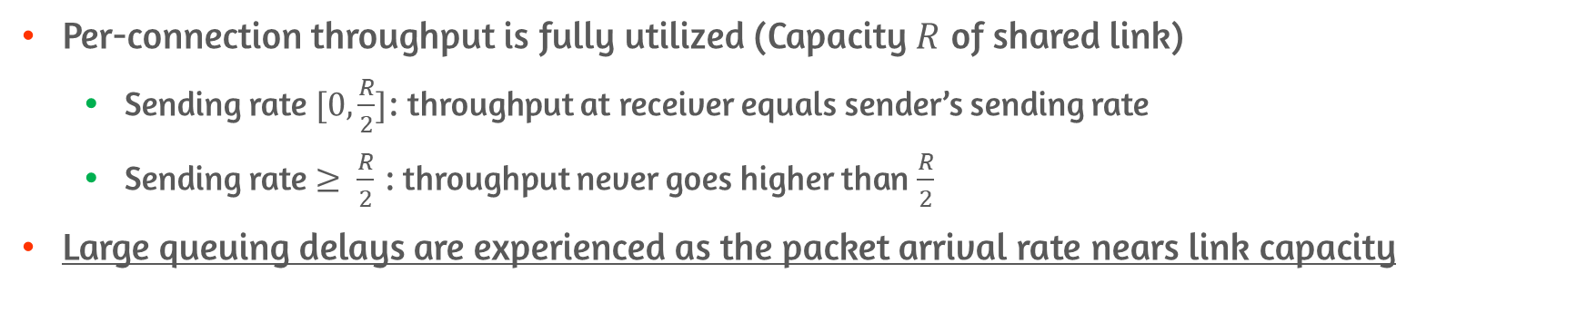
Scenario 1: Performance and Cost
Per-connection throughput is fully utilized (Capacity $R$ of shared link)
Sending rate $[0,\frac{R}{2}]$: throughput at receiver equals sender’s sending rate
Sending rate $≥ \frac{R}{2}$ : throughput never goes higher than $\frac{R}{2}$
Large queuing delays are experienced as the packet arrival rate nears link capacity
Per-connection throughput
Delay
Notes:
Throughput 측면에서는 좋은 것 같지만, delay 측면에서는 좋지 않음. Output이 sending 양을 따라가지 못하니까 계속 쌓이게 됨
근데, 재전송이 발생하는 경우는 아님. Delay가 있어도 재전송은 일어나지 않음

Slide 75
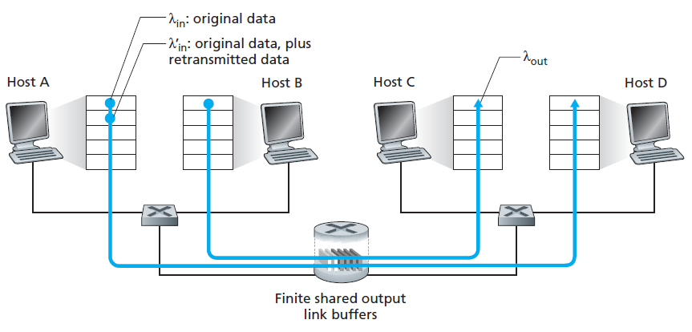
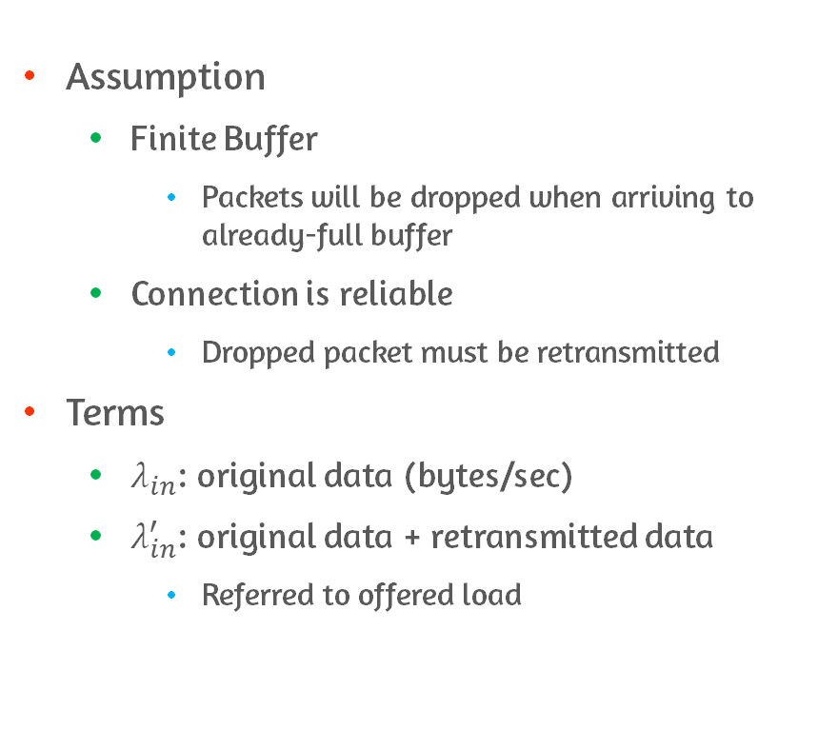
Scenario 2: Two Senders and Router with Finite Buffers
Assumption
Finite Buffer
Packets will be dropped when arriving to already-full buffer
Connection is reliable
Dropped packet must be retransmitted
Terms
$λ_{in}$: original data (bytes/sec)
$λ_{in}^{′}$: original data + retransmitted data
Referred to offered load
Notes:
여기서는 packet 재전송이 일어나므로, 전송되는 패킷이 실제로 생성된 데이터보다 많음

Slide 76
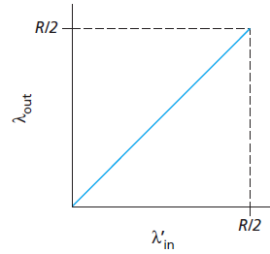
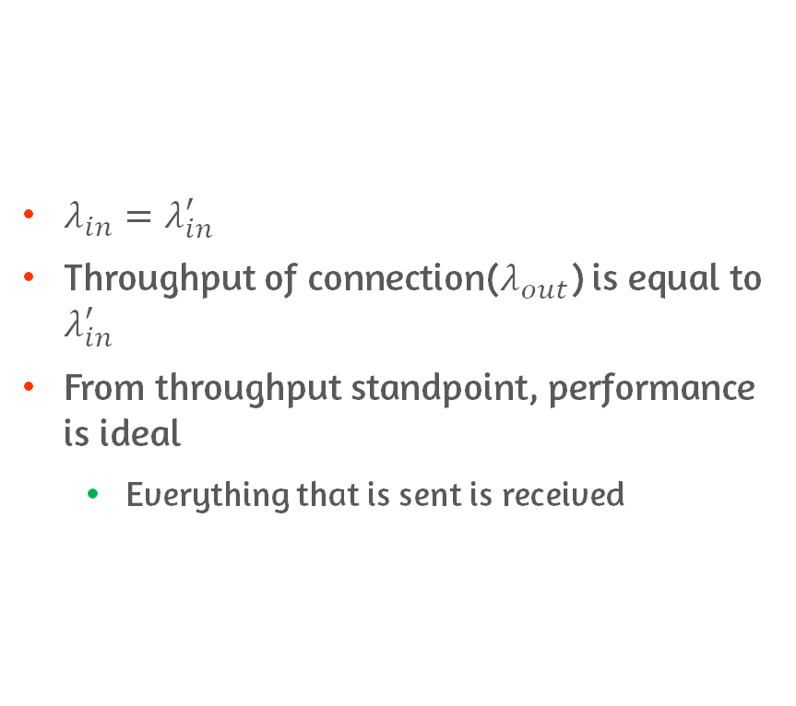
Scenario 2-(1): Send Packet When Buffer is Free
$λ_{in}=λ_{in}^{′}$
Throughput of connection($λ_{out}$) is equal to $λ_{in}^{′}$
From throughput standpoint, performance is ideal
Everything that is sent is received
Throughput of connection
Notes:
여기서 performance는 retransmission에 영향을 받는다고 할 수 있음

Slide 77
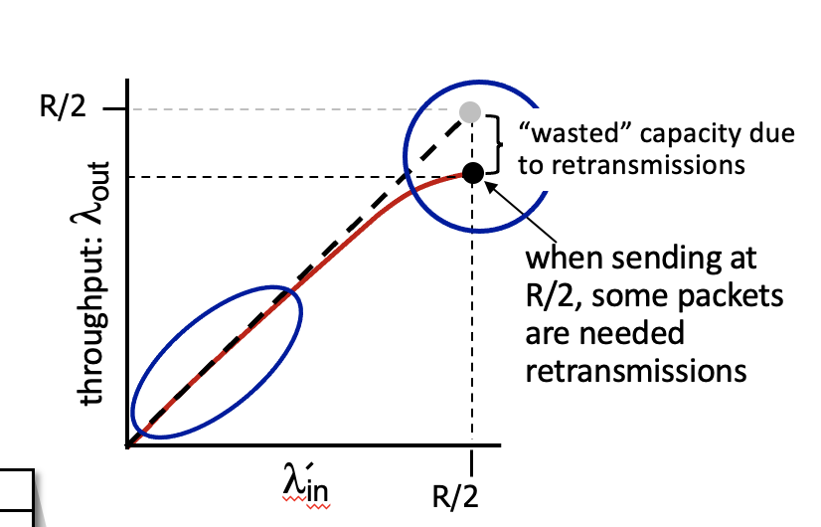
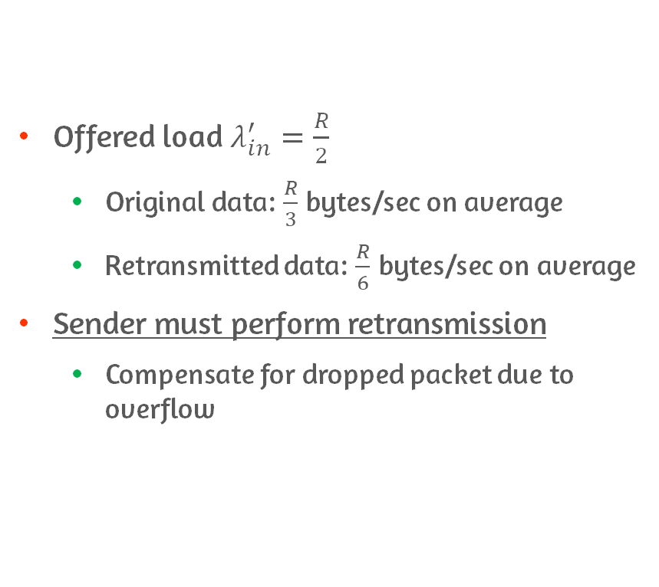
Scenario 2-(2): Sender Retransmit Only When Packet is Known to be Lost
Offered load $λ_{in}^{′}=\frac{R}{2}$
Original data: $\frac{R}{3}$ bytes/sec on average
Retransmitted data: $\frac{R}{6}$ bytes/sec on average
Sender must perform retransmission
Compensate for dropped packet due to overflow
Throughput of connection
Notes:
버퍼가 가득 차서 패킷이 drop 되면서 재전송 -> 그로 인한 비효율

Slide 78

Scenario 2-(3): Sender Timeout Prematurely and Retransmit Packet
Retransmit packet delayed in queue but not yet lost
Both original and retransmission reach to receiver
Receiver discard retransmission
Forwarding retransmitted packet on router is wasted
May be used to send different packet instead
Unneeded retransmission cause router to use link bandwidth to forward unneeded packet
Throughput of connection

Slide 79
Approaches to Congestion Control
End-to-End
Network-assisted
Network layer provides no explicit support for congestion control
End system must infer congestion
By packet loss and delay
TCP take this approach
Indication: timeout or triple duplicated ACK
Congestion control: TCP decrease window size or increase RTT delay values
Network layer components provide explicit feedback to sender
Regarding congestion state in network
Feedback type
Direct feedback: router → sender
Router marks/updates a field in packet flowing: receiver → sender
Used in ATM available bit-rate(ABR) congestion control

Slide 80

ATM ABR Congestion Control
Term
Switch rather than router
Cells rather than packet
Resource Management Cells(RM cells)
Convey congestion-related information
How to inform congestion?
When RM cell arrives at destination, send back to sender
Switch generate RM cell and send RM cell directly to source

Slide 81
3.7 TCP Congestion Control

Slide 82
TCP Congestion Control
Sender limit the rate at which it sends traffic into connection
As a function of perceived network congestion
Perceived little congestion: increase send rate
Otherwise: reduce send rate
Three consideration
How TCP sender limit the rate
How TCP sender perceive congestion
What algorithm should sender use to change send rate

Slide 83

How TCP Sender Limit Rate?
Operate congestion window(cwnd)
Constraint on the rate at which TCP sender can send traffic to network
By adjusting cwnd, sender can adjust sending rate
Amount of unacknowledged data $≤\min\left\{cwnd, rwnd\right\}$

Slide 84
How TCP Sender Perceive Congestion?
Procedure from congestion to packet loss
On excessive congestion, router buffer overflow
Cause dropped datagram
Loss event at the sender
Indication of congestion: loss event
Timeout
Three duplicate ACKs

Slide 85
How about Perceiving Congestion-Free?
Optimistic case: network is congestion-free
If TCP take arrival of all acknowledgments
Indication that all is well
Use ACK to increase congestion window size
And so, increase transmission rate
Referred to self-clocking

Slide 86
How TCP Sender Determine Send Rate?
For not congesting network, but make use of all available bandwidth
Principles
Lost segment implies “congestion”
Send rate should be decrease when segment is lost
Timeout or three duplicate ACKs
Acknowledged segment indicates “sender can increase send rate”
Network is not congested
Bandwidth probing
Transmission rate is increased in response to arriving ACKs
Reduce transmission rate when loss event occurs

Slide 87

What Algorithm Should Sender Use to Change Send Rate?
Slow start
Congestion avoidance
Fast recovery
Optional

Slide 88
Slow Start: Start Point
Set cwnd = 1MSS
TCP sender find amount of available bandwidth quickly, in slow-start state
cwnd increases by 1 MSS every time a transmitted segment is first acknowledged
Doubling of sending rate every RTT

Slide 89
Slow Start: End Point
Timeout
Set ssthresh(slow start threshold) to cwnd/2
Set cwnd to 1 and process a new
cwnd equals to ssthresh
TCP transition into congestion avoidance mode and increase cwnd more cautiously
Three duplicate ACKs are detected
TCP perform fast retransmit
Enter fast recovery
Notes:
첫 번째 = 네트워크 바빠서 패킷이 잘 오가지 못하는 상태
두 번째 = 네트워크 congestion 임박
세 번째 = 특정 ACK 빼고 나머지가 오고는 있으니까 -> 첫 번째보다 상대적으로 덜 심각한 상태로 본다

Slide 90
Congestion Avoidance
On entry to congestion-avoidance state, when congestion is just around the corner
Increase value of cwnd by single MSS every RTT
Congestion avoidance’s linear increase end at
Timeout -> slow start
Set cwnd to 1 MSS
Set ssthresh to cwnd/2
Three duplicate ACKs are detected: less drastic than timeout-indicated loss
Set cwnd to cwnd/2 + 3 MSS
Set ssthresh to cwnd/2
Then, fast recovery state is entered

Slide 91
Fast Recovery
cwnd is increased by 1 MSS for every duplicate ACK received
ACK arrives for missing segment
Deflate cwnd
TCP enter congestion-avoidance state
Timeout occurs
Set cwnd to 1 MSS
Set ssthresh to cwnd/2
Fast recovery transition to slow-start state

Slide 92

Example: TCP Reno

Slide 93

FSM for TCP Congestion Control

Slide 94
Conclusion
See how application layer and transport layer communicates
Learn how UDP works and its benefit
Learn how transport layer provides logical connection
Overview the many way of dealing with packet loss, time out
Learn how TCP works
TCP flow control
TCP congestion control

